Slide 1
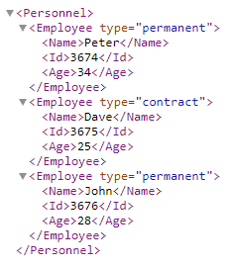
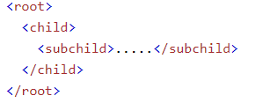
XML Tree
XML documents form a tree structure that starts at "the root" and branches to "the leaves".
XML documents are formed as element trees.
An XML tree starts at a root element and branches from the root to child elements.
All elements can have sub elements (child elements)
The terms parent, child, and sibling are used to describe the relationships between elements.
Parents have children. Children have parents. Siblings are children on the same level (brothers and sisters).
All elements can have text content (Peter) and attributes (type=“permanent").

